Slide 1
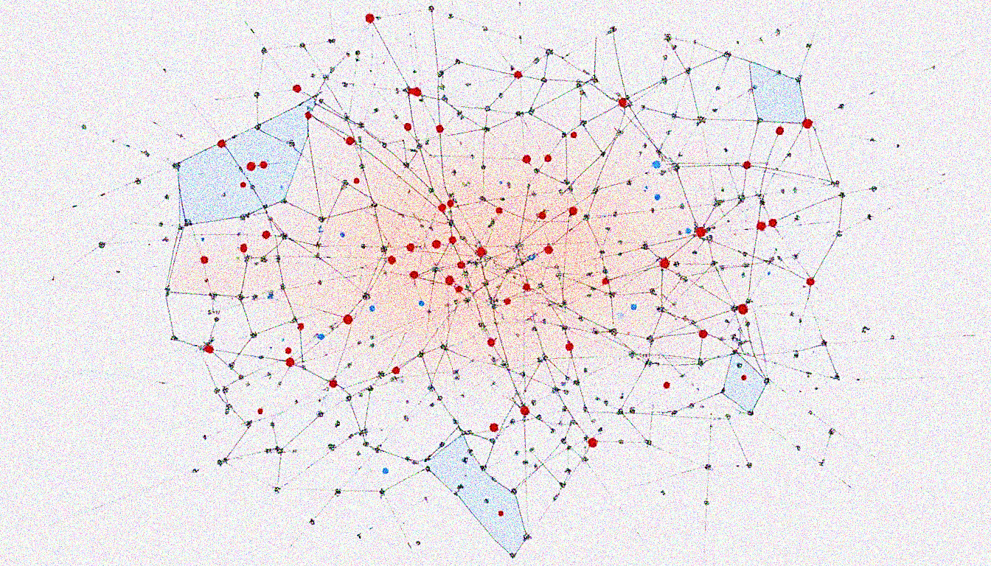

Lecture 3: Nearest Neighbor Algorithm
CSE445 Machine Learning
Jilan Samiuddin
Assistant Professor
North South University

Slide 2
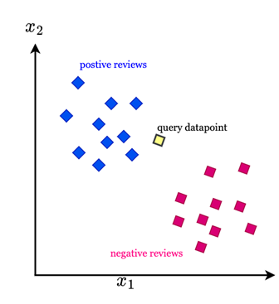
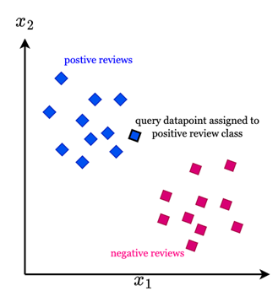
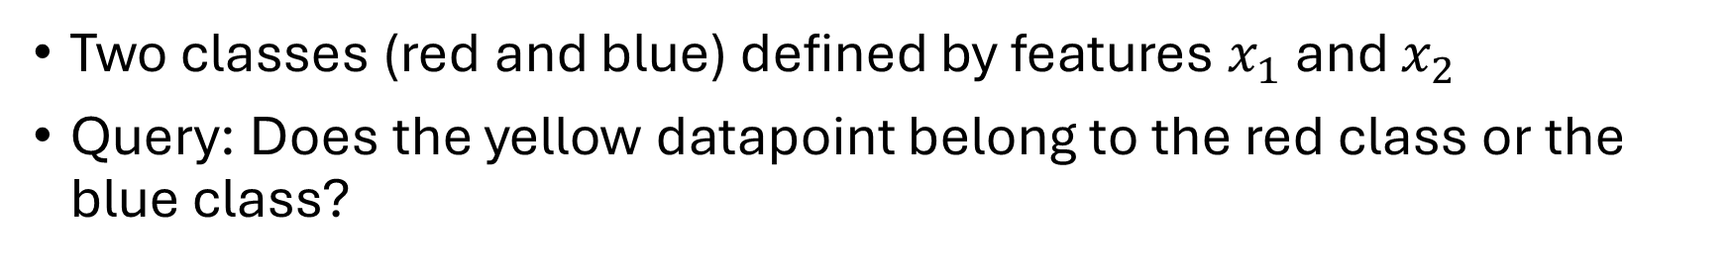
Nearest Neighbor Algorithm Intuition
Two classes (red and blue) defined by features $x_{1}$ and $x_{2}$
Query: Does the yellow datapoint belong to the red class or the blue class?
Answer is blue because the nearby points are blue

Slide 3
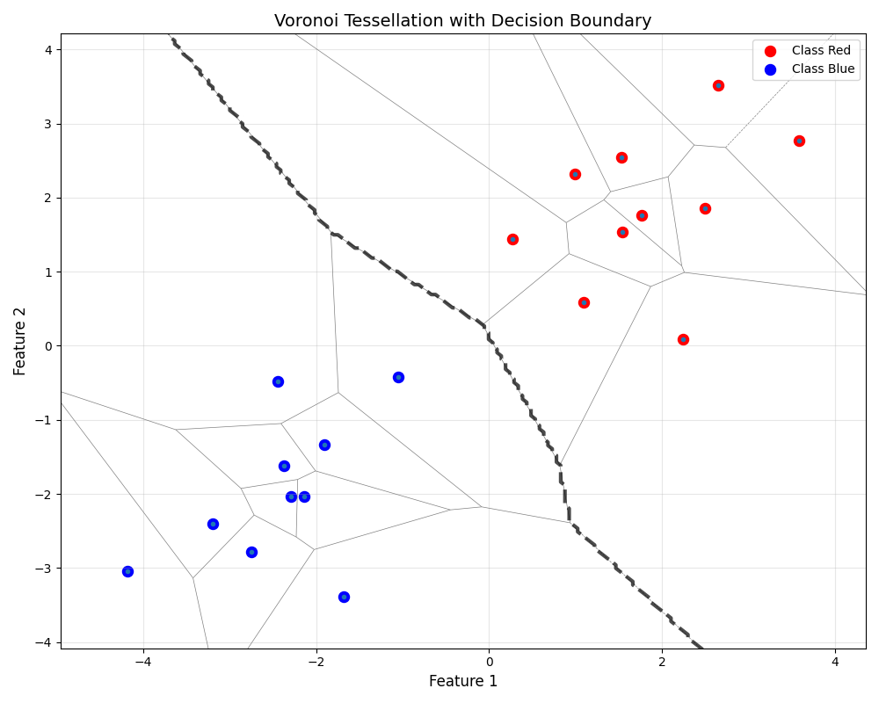
Voronoi Tessellation and Decision Boundary
Voronoi Tesselation
Partitions space into regions
Points on the boundary are at same distance from two different training examples
Decision Boundary
Nonlinear
Classifies the two classes well

Slide 4
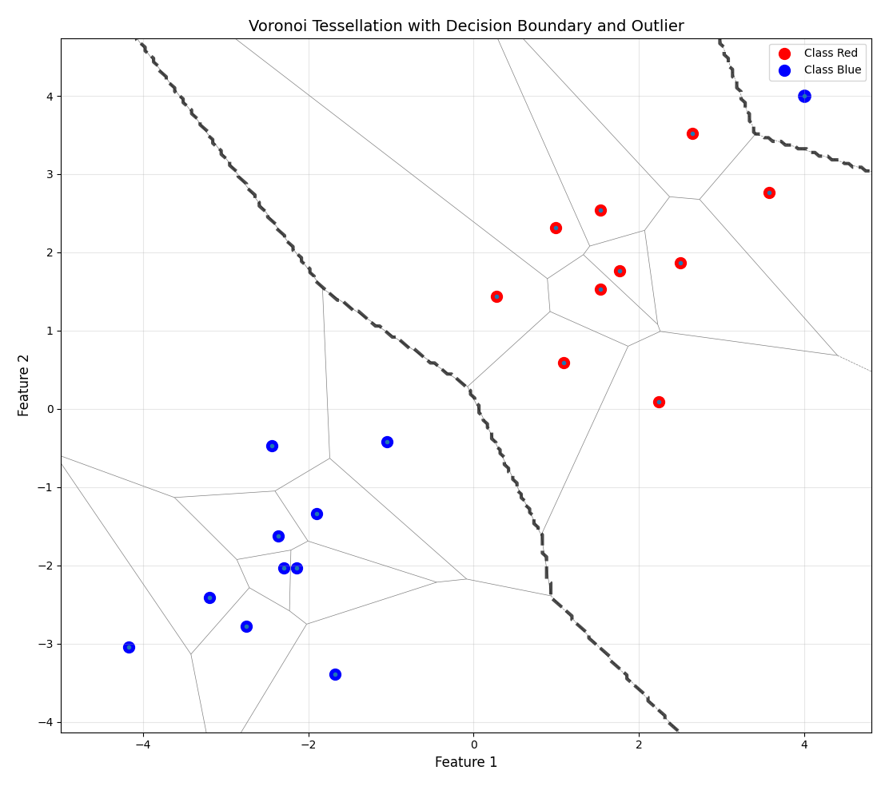
Outliers
Algorithm is sensitive to outliers
Distorted decision boundaries
Points near the outlier might be misclassified
A single wrongly labeled or extreme data point can affect predictions for many test cases
Idea:
Use more than one nearest neighbor to make decision

Slide 5
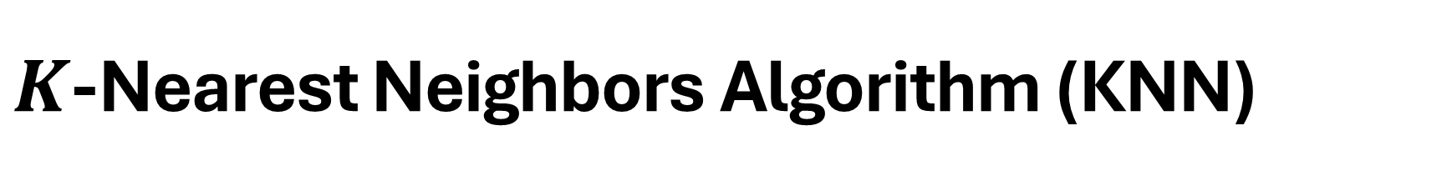
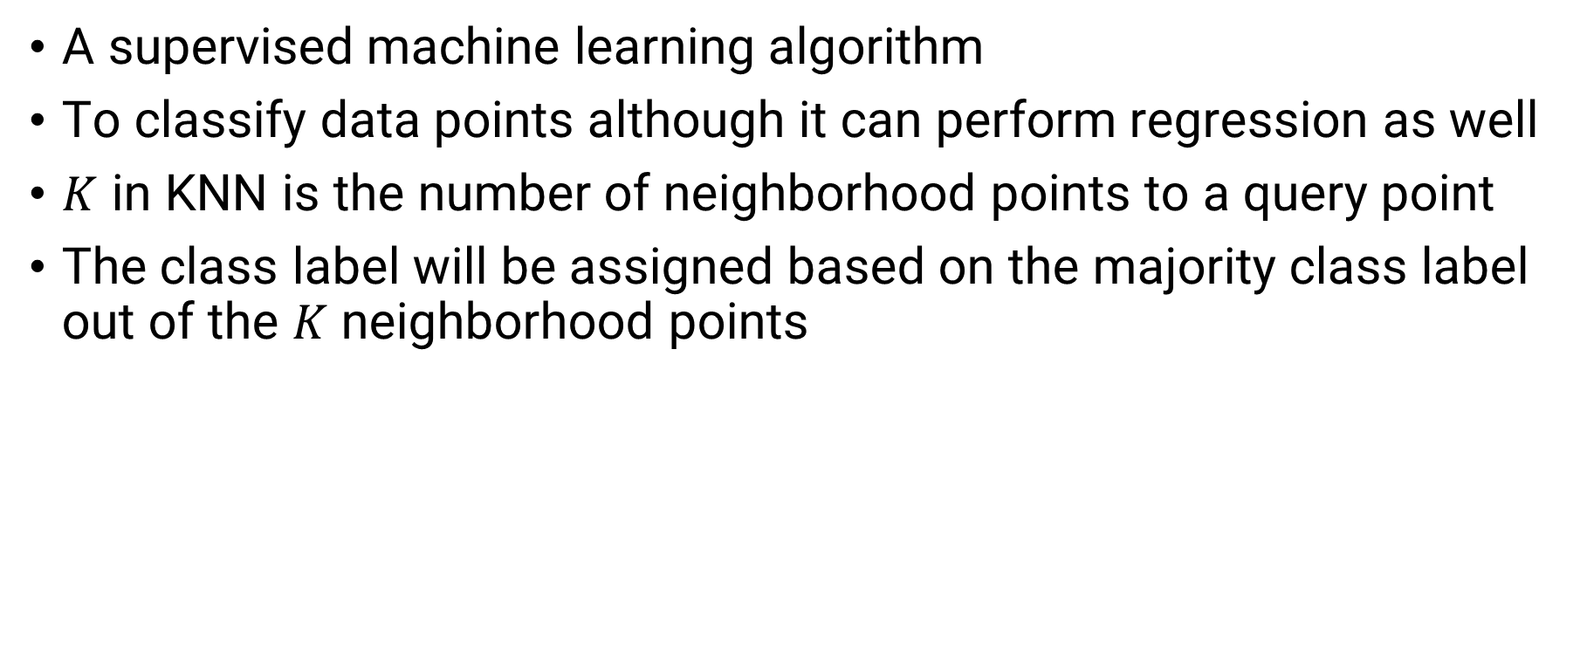
$K$-Nearest Neighbors Algorithm (KNN)
A supervised machine learning algorithm
To classify data points although it can perform regression as well
$K$ in KNN is the number of neighborhood points to a query point
The class label will be assigned based on the majority class label out of the $K$ neighborhood points

Slide 6
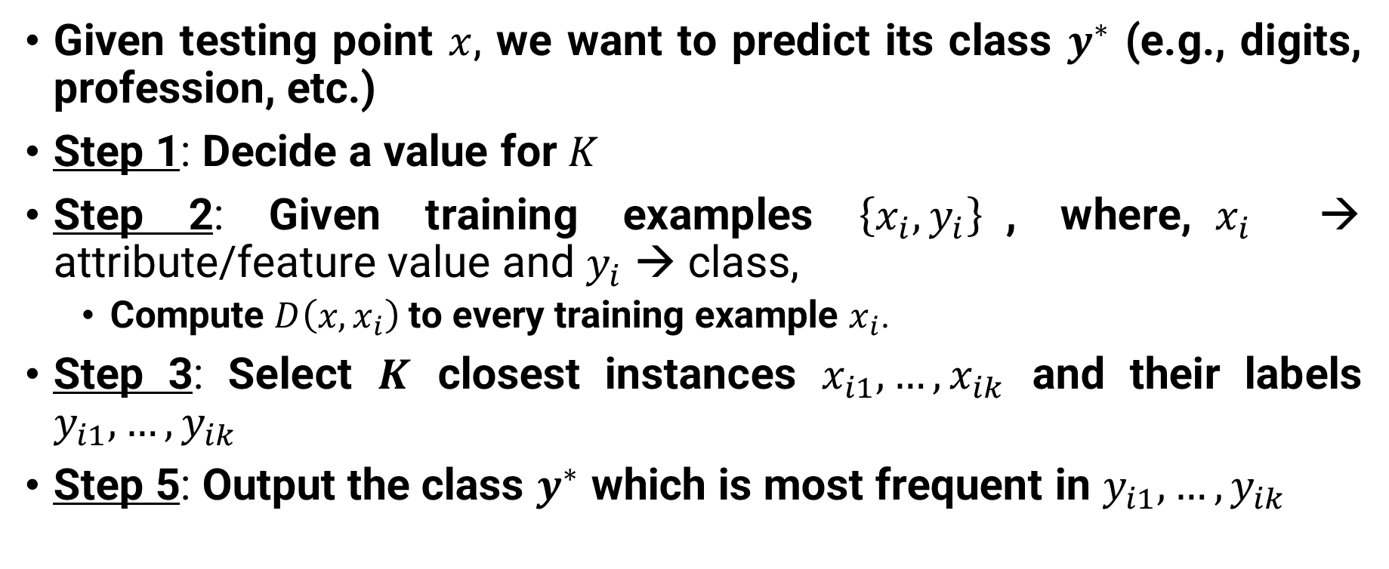
Classification using KNN – Steps
Given testing point $x$, we want to predict its class $y^{∗}$ (e.g., digits, profession, etc.)
Step 1: Decide a value for $K$
Step 2: Given training examples $\left\{x_{i},y_{i}\right\}$, where,$x_{i}$ → attribute/feature value and $y_{i}$ → class,
Compute $D\left(x,x_{i}\right)$ to every training example $x_{i}$.
Step 3: Select $K$ closest instances $x_{i1},…,x_{ik}$ and their labels $y_{i1},…,y_{ik}$
Step 5: Output the class $y^{∗}$ which is most frequent in $y_{i1},…,y_{ik}$

Slide 7
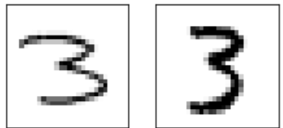
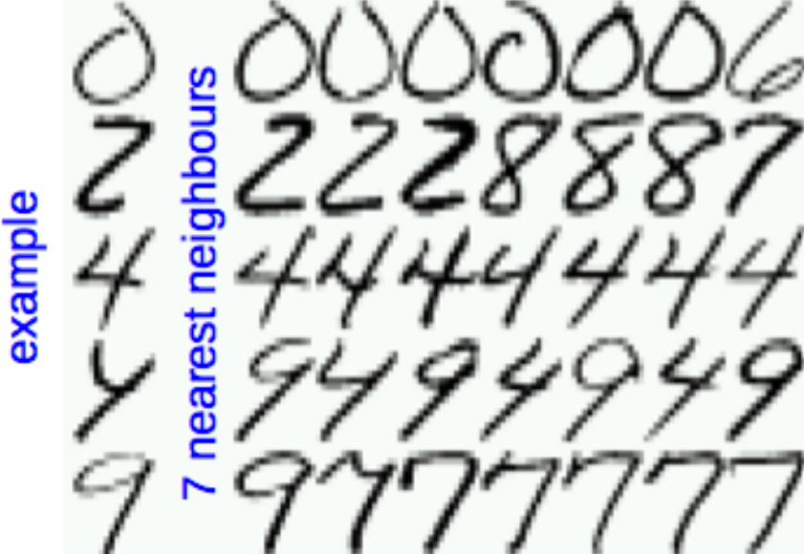
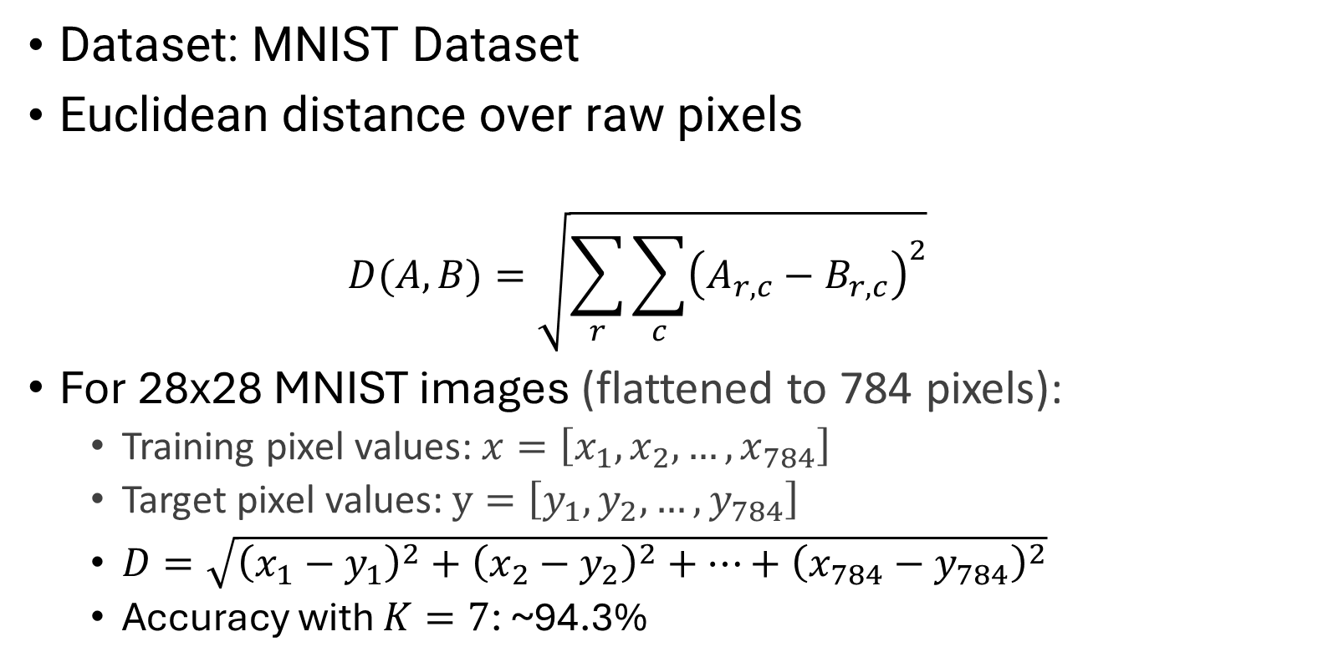

Example: Handwritten Digits Classification
A
B
Dataset: MNIST Dataset
Euclidean distance over raw pixels
$$D(A,B)=\sqrt{\sum_{r}{\sum_{c}{{\left(A_{r,c}−B_{r,c}\right)}^{2}}}}$$
For 28x28 MNIST images (flattened to 784 pixels):
Training pixel values: $x=\left[x_{1},x_{2},…,x_{784}\right]$
Target pixel values: $y=\left[y_{1},y_{2},…,y_{784}\right]$
$D=\sqrt{{\left(x_{1}−y_{1}\right)}^{2}+{\left(x_{2}−y_{2}\right)}^{2}+…+{\left(x_{784}−y_{784}\right)}^{2}}$
Accuracy with $K=7$: ~94.3%
$$K=7$$

Slide 8
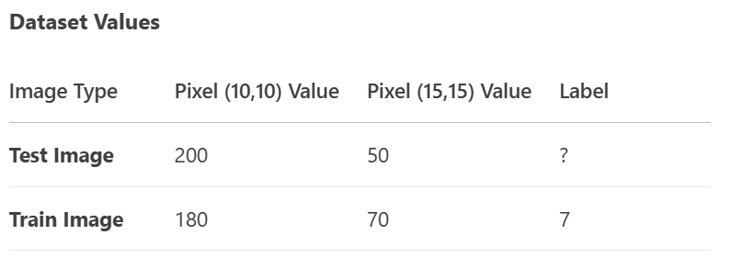
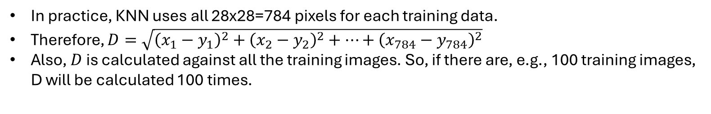
Example: Mathematical
Suppose, we take two pixels from the 28x28 grid:
Note: The pixel values are taken randomly,
and are not from actual MNIST dataset
D
In practice, KNN uses all 28x28=784 pixels for each training data.
Therefore, $D=\sqrt{{\left(x_{1}−y_{1}\right)}^{2}+{\left(x_{2}−y_{2}\right)}^{2}+…+{\left(x_{784}−y_{784}\right)}^{2}}$
Also, $D$ is calculated against all the training images. So, if there are, e.g., 100 training images, D will be calculated 100 times.

Slide 9
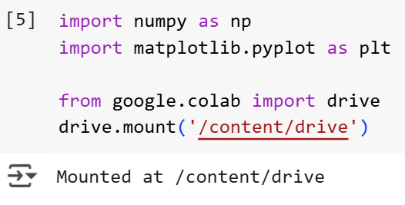
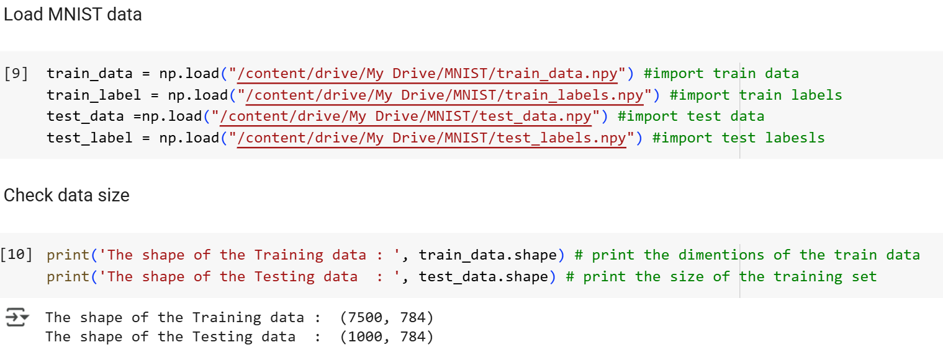
Let’s code MNIST classification using KNN!

Slide 10
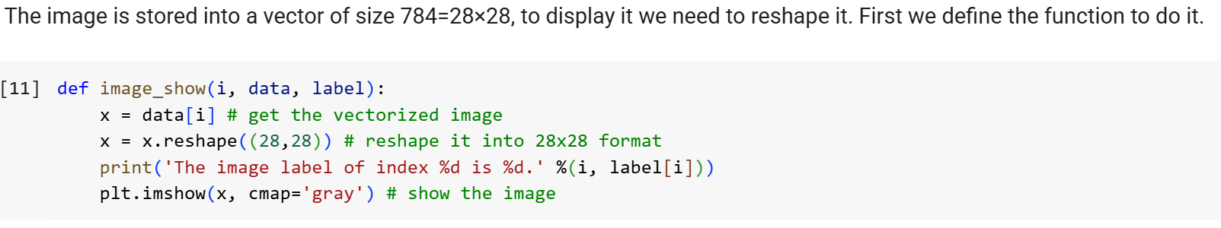
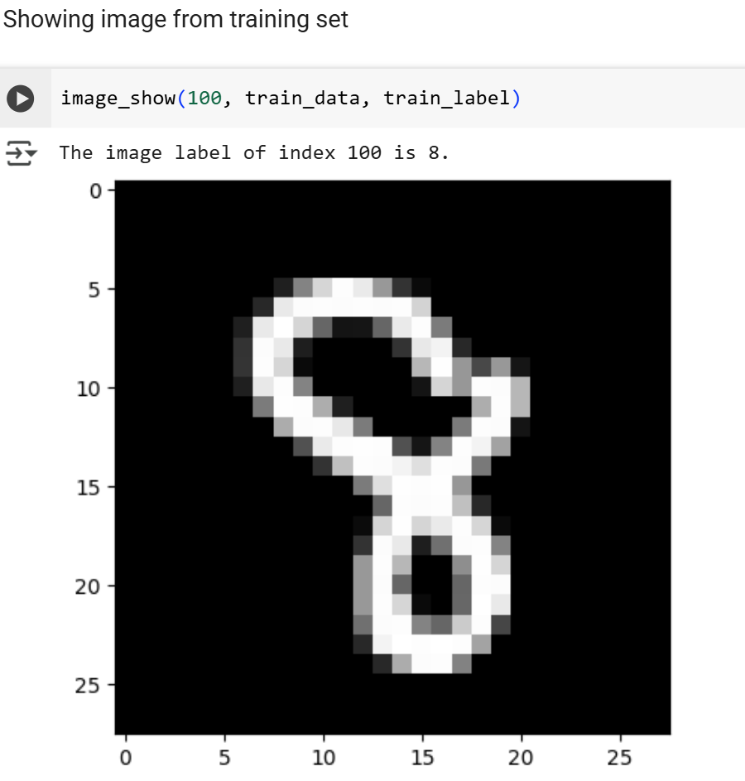
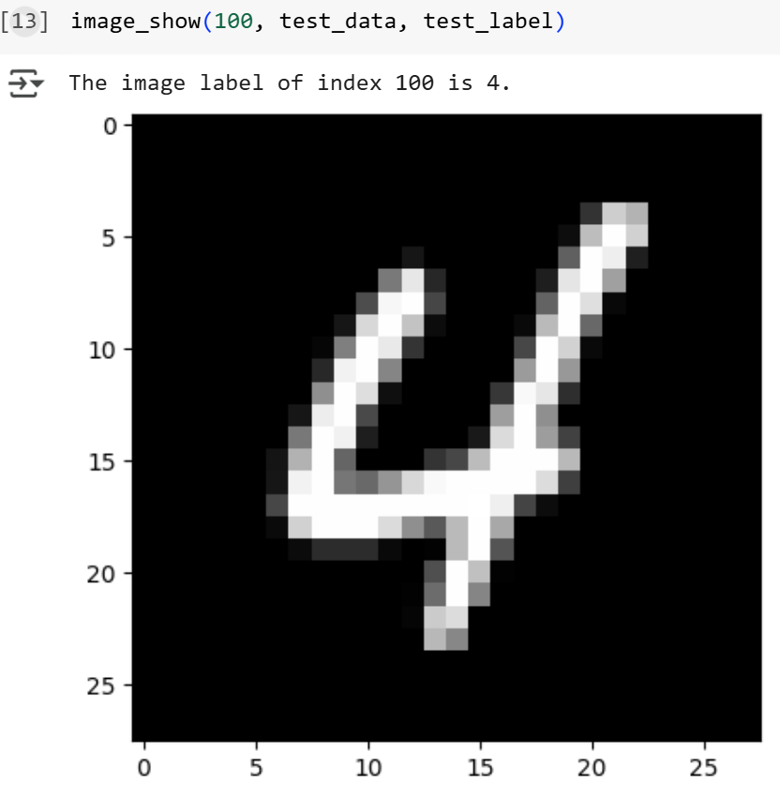
Code (contd.)

Slide 11
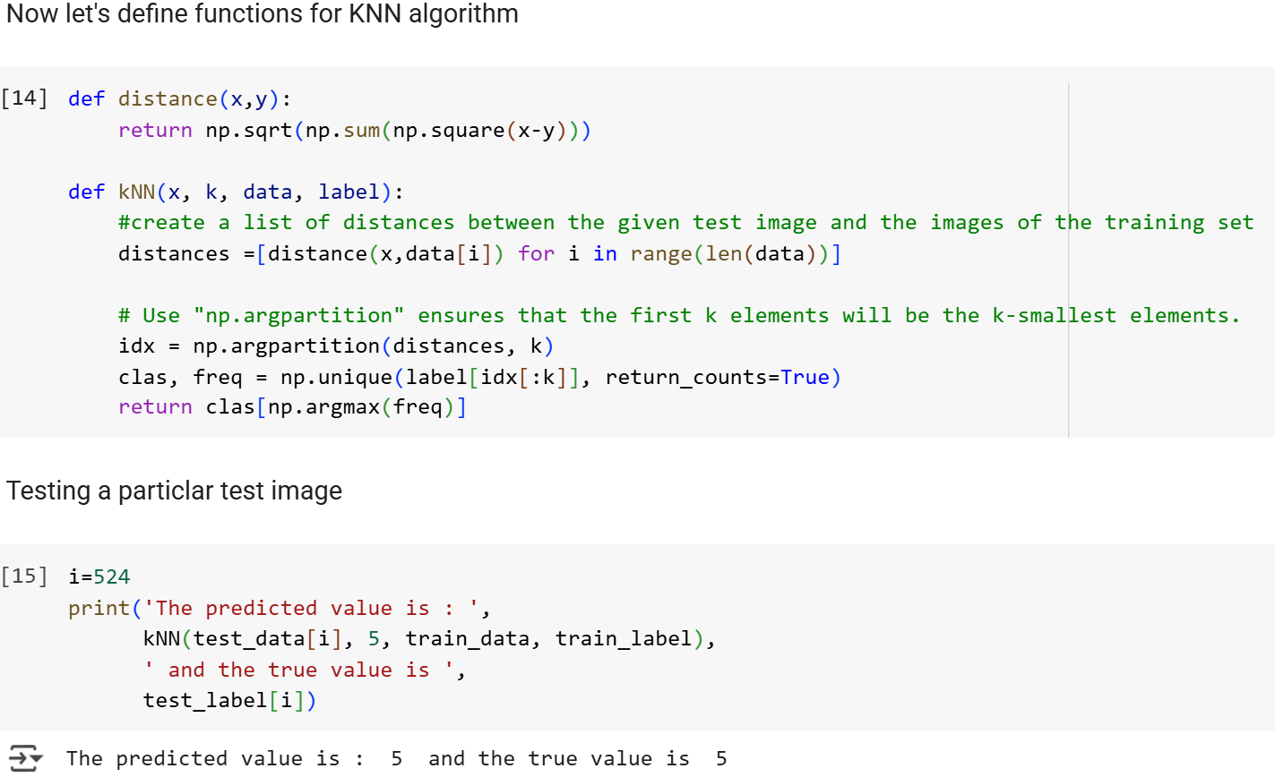
Code (contd.)

Slide 12
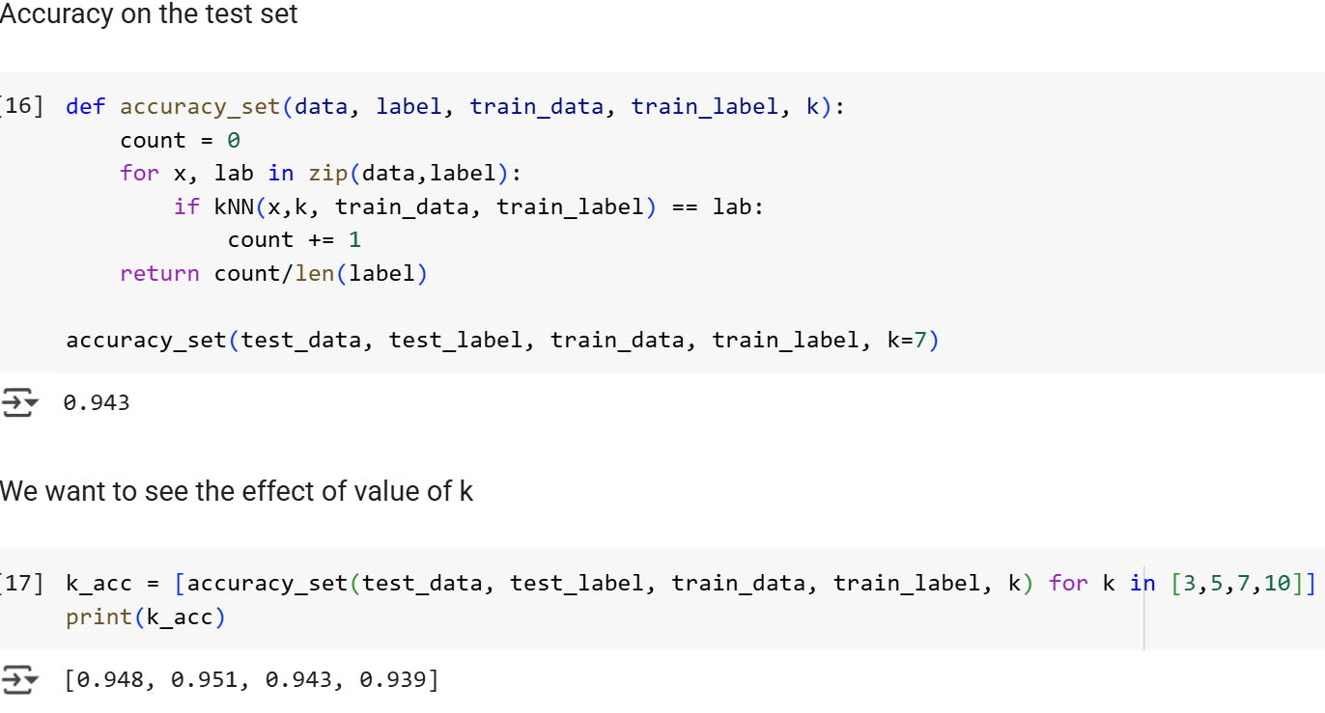
Code (contd.)

Slide 13
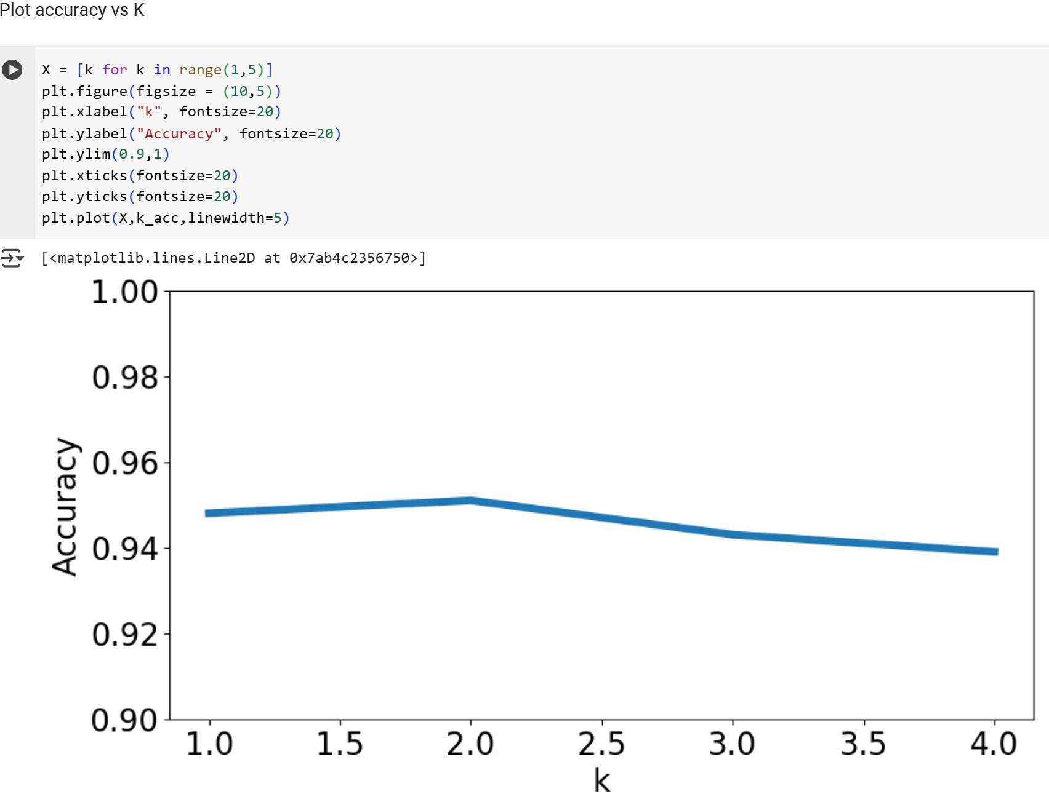
Code (contd.)

Slide 14
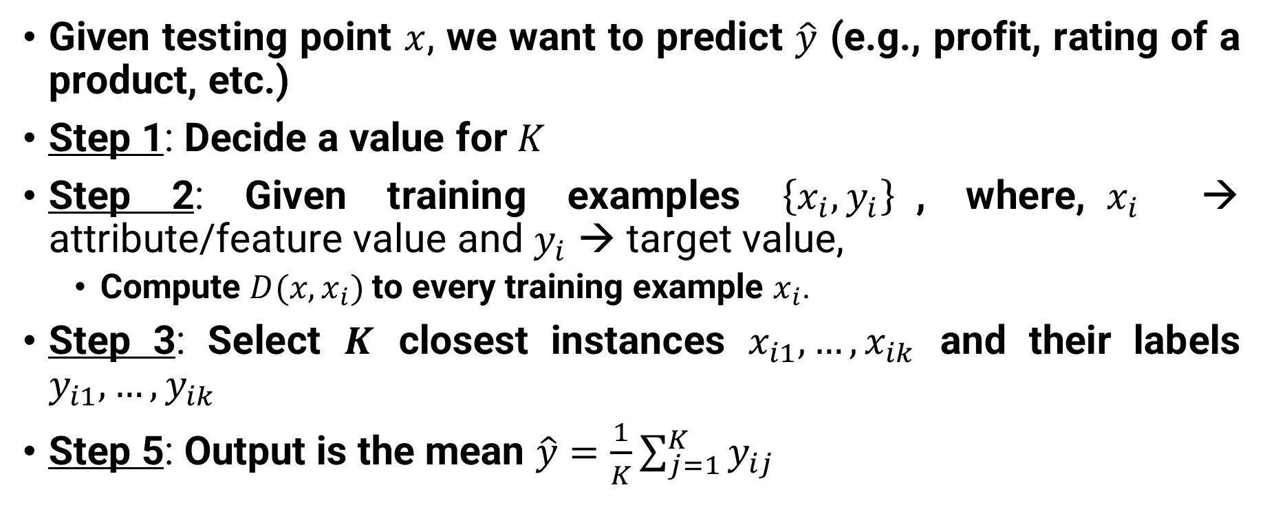
Regression using KNN – Steps
Given testing point $x$, we want to predict $\hat{y}$ (e.g., profit, rating of a product, etc.)
Step 1: Decide a value for $K$
Step 2: Given training examples $\left\{x_{i},y_{i}\right\}$, where,$x_{i}$ → attribute/feature value and $y_{i}$ → target value,
Compute $D(x,x_{i})$ to every training example $x_{i}$.
Step 3: Select $K$ closest instances $x_{i1},…,x_{ik}$ and their labels $y_{i1},…,y_{ik}$
Step 5: Output is the mean $\hat{y}=\frac{1}{K}\sum_{j=1}^{K}{y_{ij}}$

Slide 15
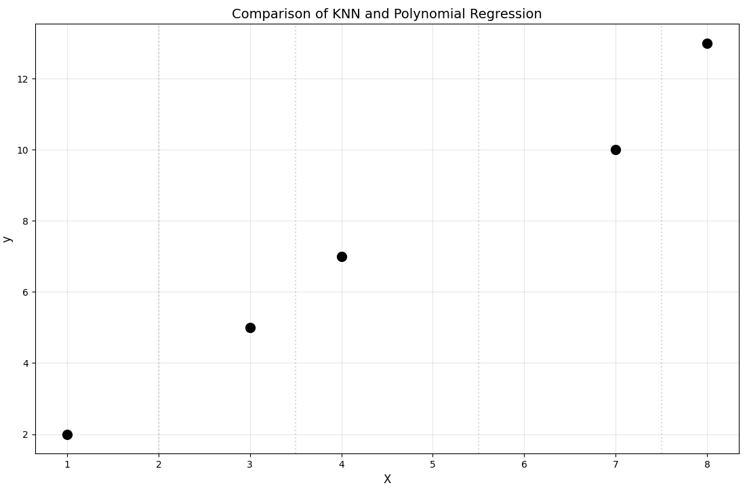

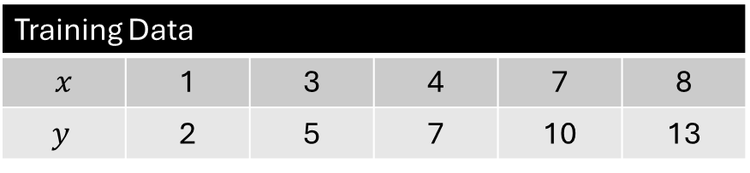
Example: Polynomial function
What is the target value when $x=5$?
Training Data
$$x$$ | 1 | 3 | 4 | 7 | 8
$$y$$ | 2 | 5 | 7 | 10 | 13
Practice: Write a Python code to
solve the problem using KNN.
Results are on the next slide for
you to compare.

Slide 16
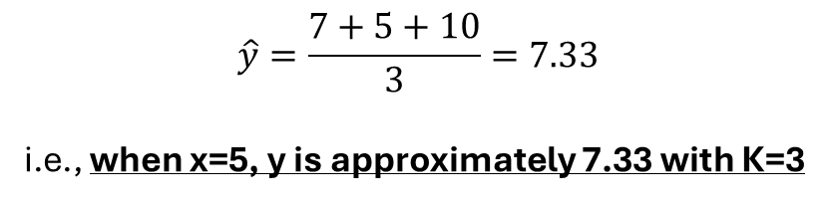
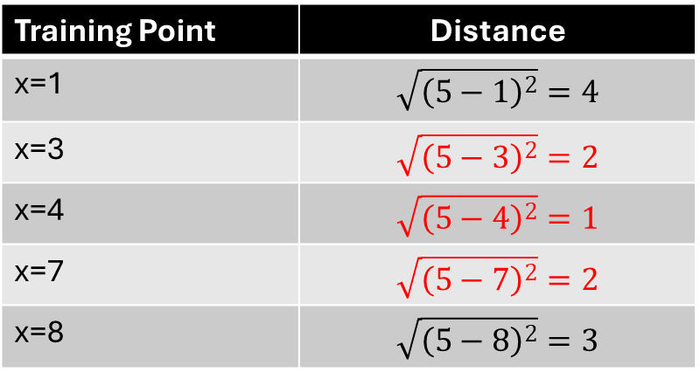
Mathematical Solution
What is the target value when $x=5$?
Training Data
$$x$$ | 1 | 3 | 4 | 7 | 8
$$y$$ | 2 | 5 | 7 | 10 | 13
$$\hat{y}=\frac{7+5+10}{3}=7.33$$
i.e., when x=5, y is approximately 7.33 with K=3
Training Point | Distance
x=1 | $$\sqrt{{\left(5−1\right)}^{2}}=4$$
x=3 | $$\sqrt{{\left(5−3\right)}^{2}}=2$$
x=4 | $$\sqrt{{\left(5−4\right)}^{2}}=1$$
x=7 | $$\sqrt{{\left(5−7\right)}^{2}}=2$$
x=8 | $$\sqrt{{\left(5−8\right)}^{2}}=3$$

Slide 17
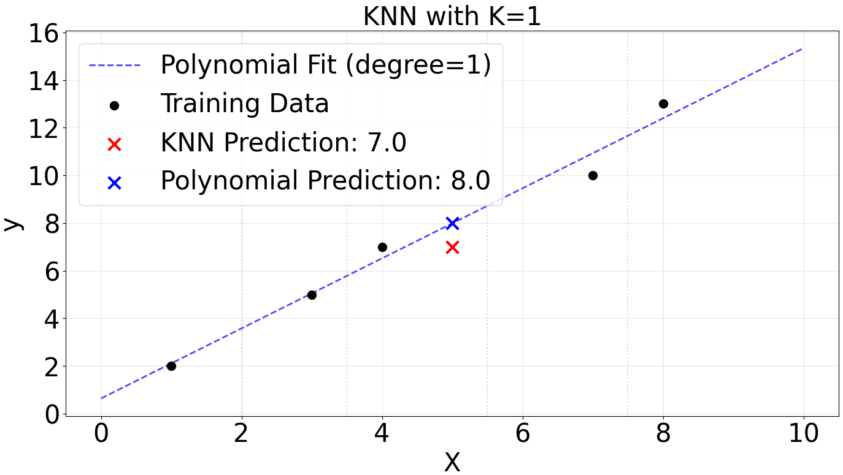
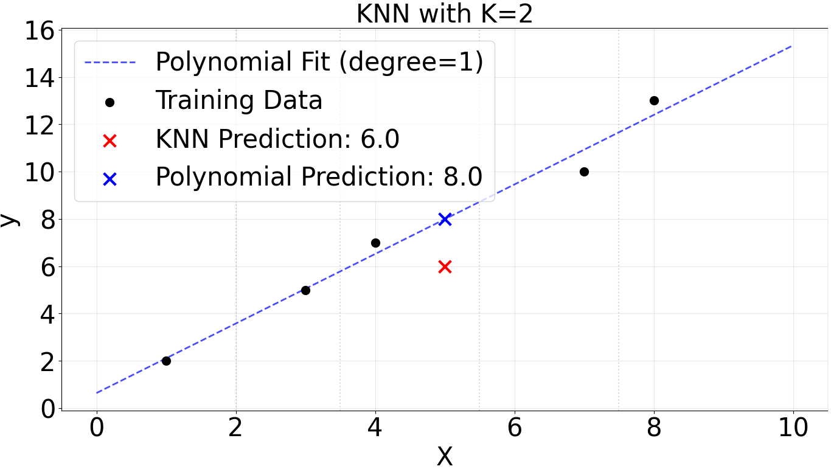
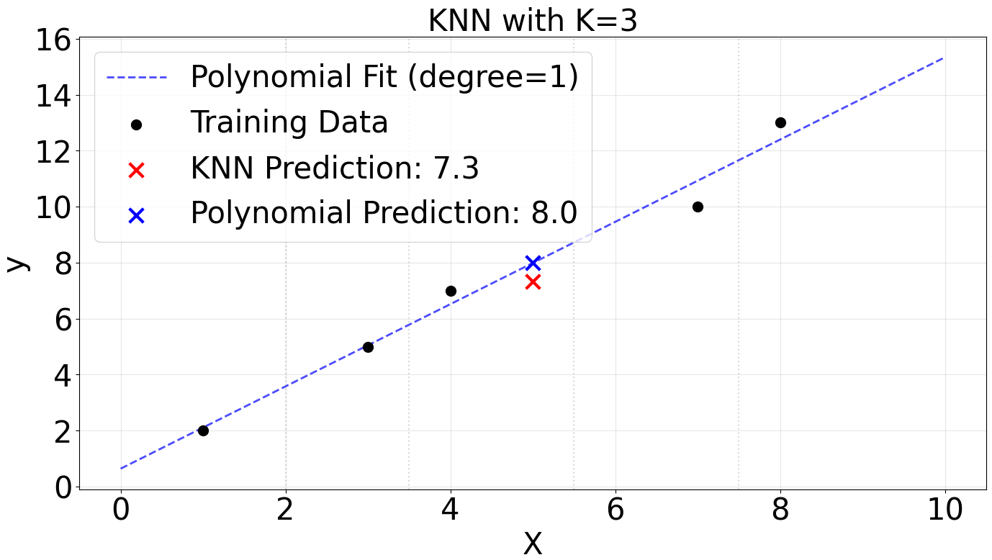
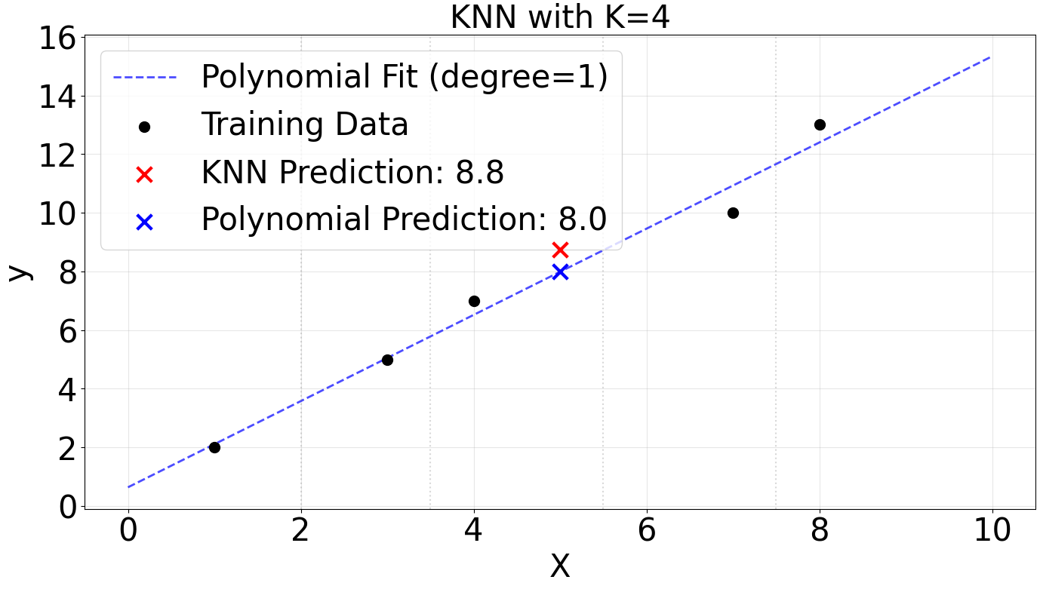
Solution for the regression example

Slide 18
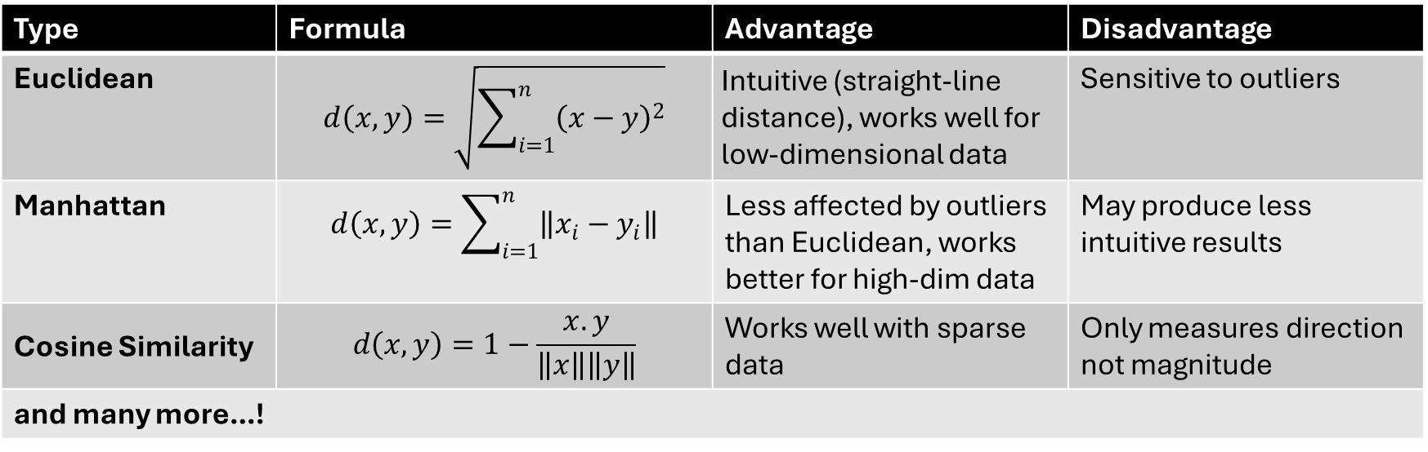
Distance measures in KNN
Type | Formula | Advantage | Disadvantage
Euclidean | $$d\left(x,y\right)=\sqrt{\sum_{i=1}^{n}{{\left(x−y\right)}^{2}}}$$ | Intuitive (straight-line distance), works well for low-dimensional data | Sensitive to outliers
Manhattan | $$d\left(x,y\right)=\sum_{i=1}^{n}{\left\|x_{i}−y_{i}\right\|}$$ | Less affected by outliers than Euclidean, works better for high-dim data | May produce less intuitive results
Cosine Similarity | $$d\left(x,y\right)=1−\frac{x.y}{\left\|x\right\|\left\|y\right\|}$$ | Works well with sparse data | Only measures direction not magnitude
and many more…!

Slide 19
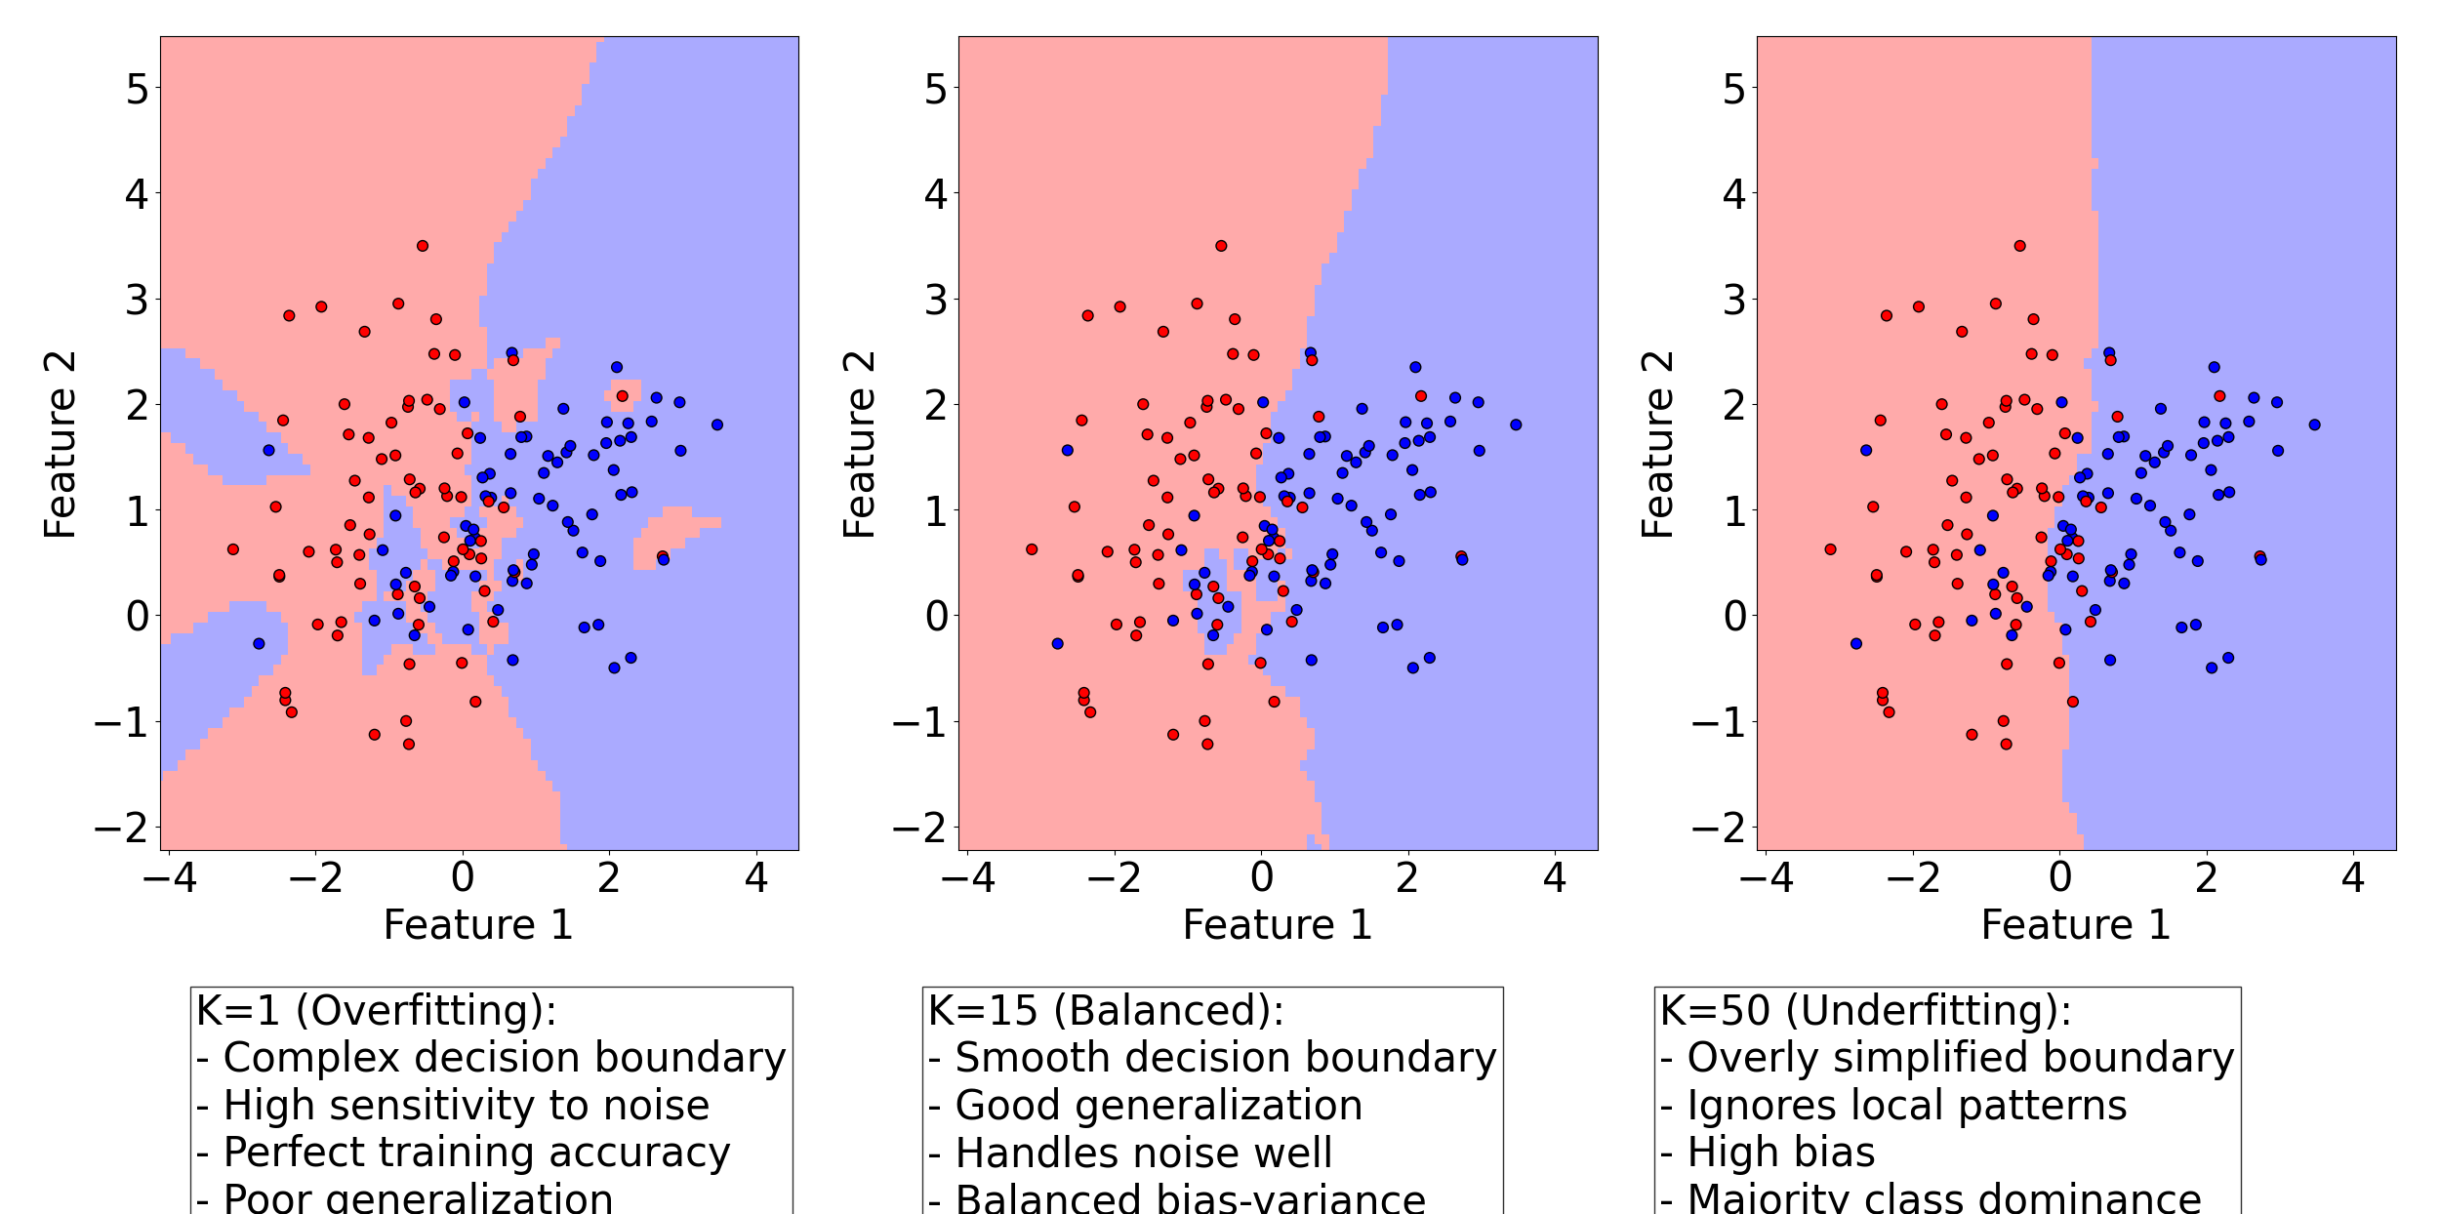

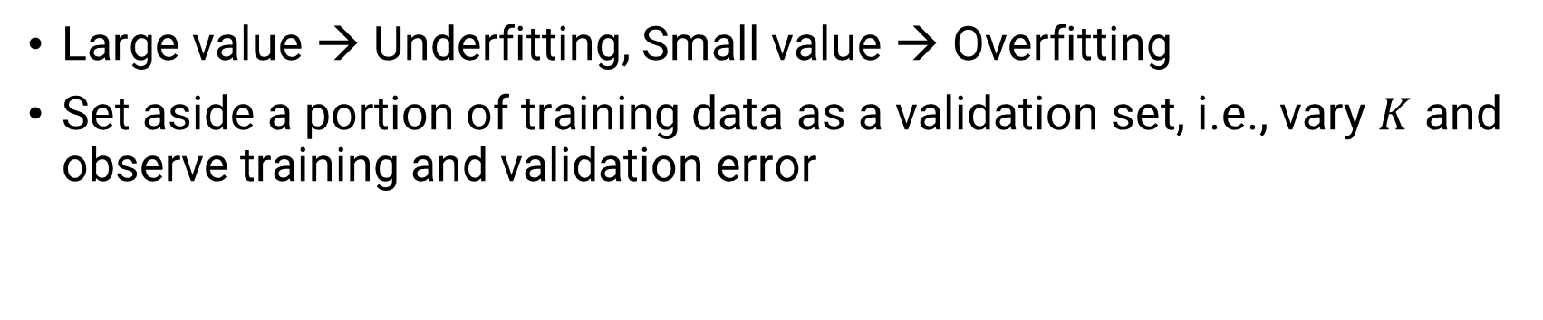
Value of $K$
Large value → Underfitting, Small value → Overfitting
Set aside a portion of training data as a validation set, i.e., vary $K$ and observe training and validation error

Slide 20
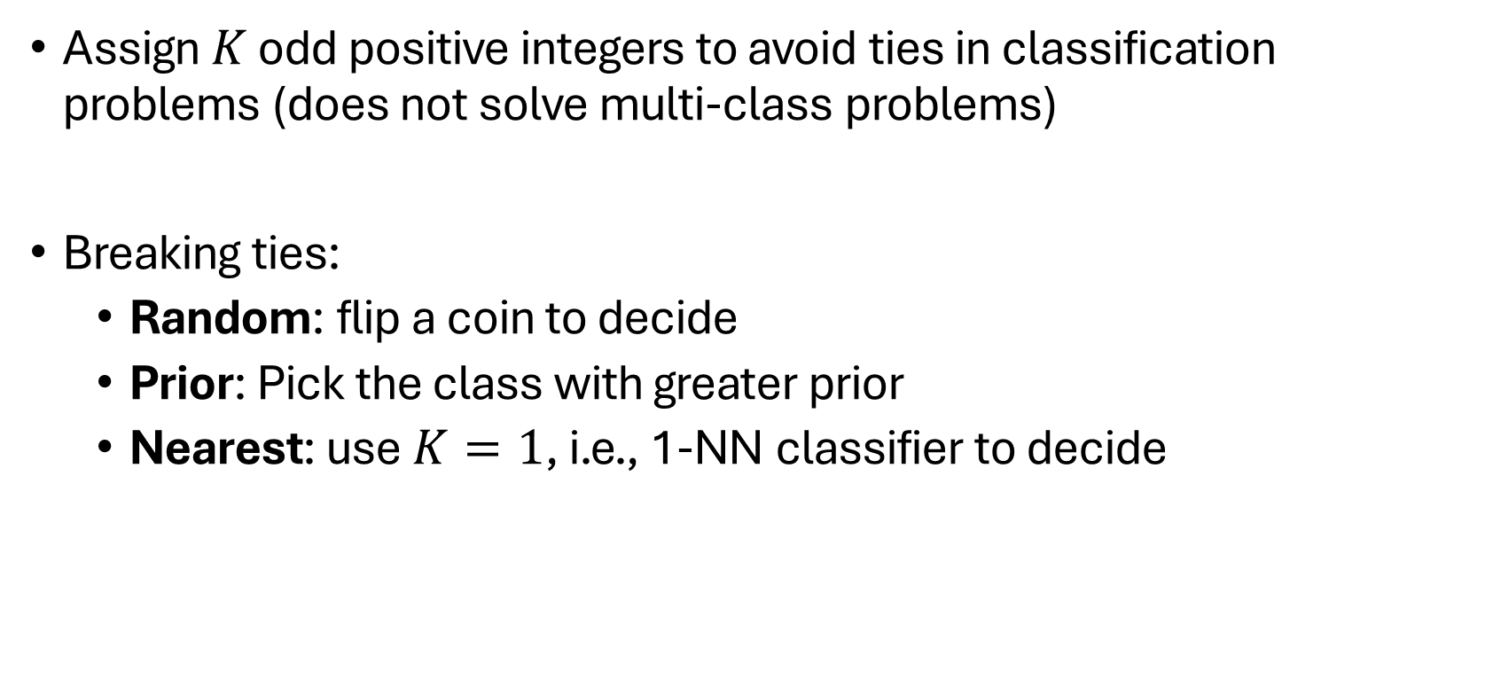
Resolving Ties
Assign $K$ odd positive integers to avoid ties in classification problems (does not solve multi-class problems)
Breaking ties:
Random: flip a coin to decide
Prior: Pick the class with greater prior
Nearest: use $K=1$, i.e., 1-NN classifier to decide

Slide 21
Advantages
Advantages | Explanation
Simple & Intuitive | Easy to understand and implement—no complex math required.
No Training Phase | Immediately ready for predictions after storing the dataset (lazy learning).
Adapts to New Data | Dynamically updates predictions as new data arrives.
Versatile | Works for both classification and regression tasks.
Interpretable | Decisions are based on actual data points (explainable predictions).

Slide 22
Disadvantages
Disadvantages | Explanation
Computationally Expensive | Slow for large datasets (must compute distances to all training points)
Curse of Dimensionality | Performance degrades with high-dimensional data (distances become meaningless)
Sensitive to Noise/Outliers | Misleading neighbors skew predictions (especially for small K)
Choice of K and Distance Metric | Poor choices lead to overfitting (small K) or underfitting (large K)
Feature Scaling Required | Sensitive to feature scales (e.g., Euclidean distance favors larger ranges)
Memory Intensive | Stores the entire training dataset (problematic for big data)
Imbalanced Data Issues | Biased toward majority classes if K is large

Slide 23
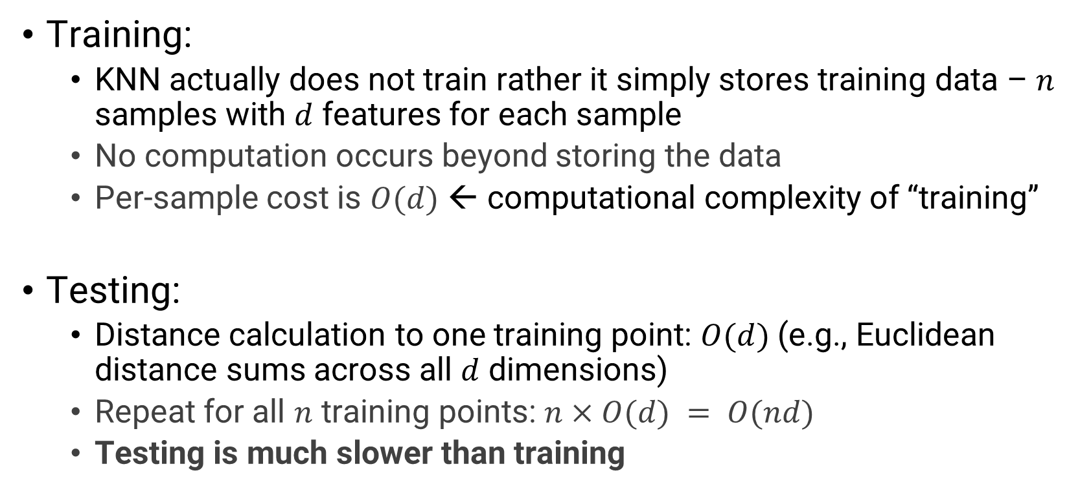
Speed of KNN
Training:
KNN actually does not train rather it simply stores training data – $n$ samples with $d$ features for each sample
No computation occurs beyond storing the data
Per-sample cost is $O(d)$ ← computational complexity of “training”
Testing:
Distance calculation to one training point: $O(d)$ (e.g., Euclidean distance sums across all $d$ dimensions)
Repeat for all $n$ training points: $n×O(d) = O(nd)$
Testing is much slower than training

Slide 24
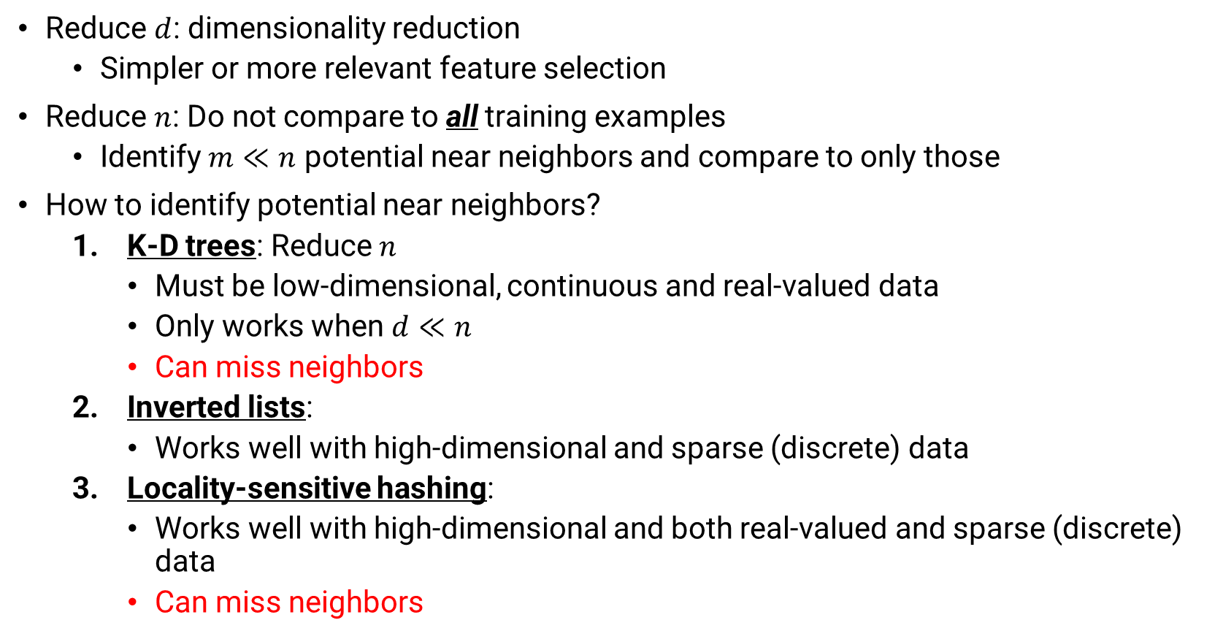
Making KNN faster
Reduce $d$: dimensionality reduction
Simpler or more relevant feature selection
Reduce $n$: Do not compare to all training examples
Identify $m≪n$ potential near neighbors and compare to only those
How to identify potential near neighbors?
K-D trees: Reduce $n$
Must be low-dimensional, continuous and real-valued data
Only works when $d≪n$
Can miss neighbors
Inverted lists:
Works well with high-dimensional and sparse (discrete) data
Locality-sensitive hashing:
Works well with high-dimensional and both real-valued and sparse (discrete) data
Can miss neighbors

